Slide 1
LinkedIn Edunet
[Usage of Credit Card Transactional Data]
P R E S E N T A T I O N 2 0 2 6
👤
Student Name
✉
Student Email
[Navya Varshini Vennela]
[honeyaji2020@gmail.com]
📖
[Mr.Bhuvanesh Sir]

Slide 2
edunet
foundation
OUTLINE
• Abstract of the Project
• Problem Statement
• Proposed Solution
• System Architecture
• Live Demo of the Project
• Embedded Video of Project
• Conclusion
• Future Scope

Slide 3
edunet
foundation
Abstract
• This project focuses on analyzing the usage of credit card transactional data to understand spending patterns and trends. The main objective is to study transaction behavior based on payment methods and product categories.
• The project is developed using Microsoft Excel with the help of pivot tables and charts for data analysis and visualization.
• The expected outcome is to present insights in a simple dashboard format, making it easy to understand transaction distribution. The key highlight of this project is the use of visual charts like pie chart and bar graph for better interpretation of data

Slide 4
edunet
foundation
Problem Statement
• Understanding credit card transactions data can be difficult due to the large volume of data and l lack of proper visualizations. It is challenging to identify spending patterns and trends without organized analysis
• This problem affects businesses and users who want to track transactions behavior and make better decisions. Existing methods are often complex or do not present data in a clear visual format
• The scope of this project is limited to analyzing transaction amount based on payment methods and product categories using simple tools for better understanding

Slide 5
edunet
foundation
Proposed Solution
The proposed solution is to analyze credit card transaction data using a simple and structured approach. The data is organized and summarized using pivot tables, and visualized using charts for better understanding.
The project is implemented using Microsoft Excel. The steps include data cleaning, creating pivot tables, and generating pie and bar charts.
This approach makes data analysis easy, improves visualization, and helps in identifying transaction patterns quickly compared to traditional methods.

Slide 6
edunet
foundation
System Architecture
Data Input / Source
Processing / Analysis
The data is taken from a credit card transaction dataset, which includes details like transaction amount, payment method, product category, and device used
The data is cleaned by removing duplicates and organized in a structured format. Pivot tables are used to analyze the data
AI / Tool Integration
Output / Dashboard
The project is implemented using Microsoft
Excel for data analysis and visualizations
The final output is a dashboard consisting of pie charts and bar graphs that clearly represent transaction patterns

Slide 7
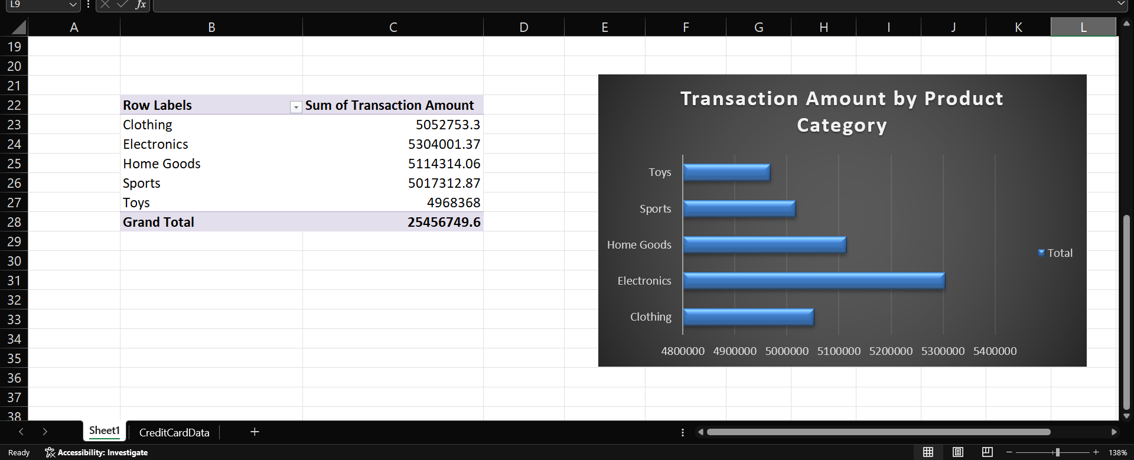
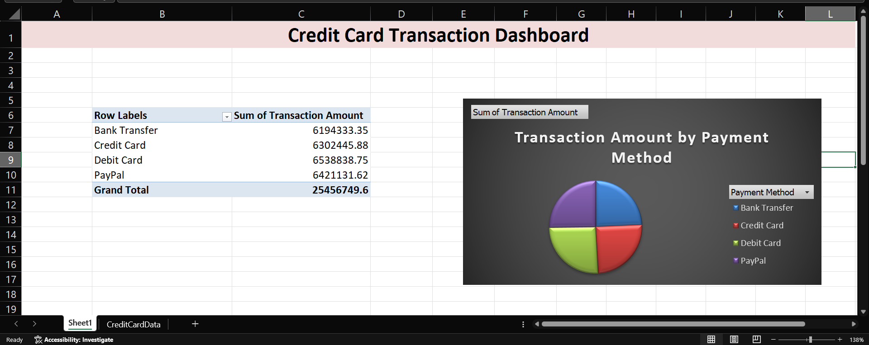
edunet
foundation
Live Demo of Project
Here's the list of some demo screenshots / features of the project:
🖼
🖼
🖼
Demo 2 This demo displays the pie chart representing transaction amount by payment method. It clearly shows the distribution of transactions across different payment options
Demo 1
This demo shows the pivot table used to summarize transaction data based on product category and payment method. It helps in organizing and analyzing the data efficiently.
Demo 3 This demo shows the bar graph representing transaction amount by product category. It helps in comparing spending patterns across different categories

Slide 8
edunet
foundation
Video of Project Demo
Credit Card Project Demo Video
▶
https://drive.google.com/file/d/1s8_ieI-9Rk0o4Ei39J8Kb03JbnR_rV15/view?usp=drivesdk

Slide 9
edunet
foundation
Conclusion
✅
This project successfully analyzes the usage of credit card transactional data using Microsoft Excel. The data was organized and visualized using pivot tables and charts to understand transaction patterns.
The key findings show how transaction amounts vary across different payment methods and product categories. The objectives of the project were achieved by creating a simple and clear dashboard.
This project adds value by making data analysis easy to understand through visual representation.
• Abstract of the Project
• Problem Statement
• Proposed Solution
• System Architecture
• Live Demo of the Project
• Embedded Video of Project
CONCLUSION
• Conclusion
• Future Scope

Slide 10
edunet
foundation
Future Scope
Step 1:
Improve dataset
Step 2: Add Advanced Analysis
In the future, this project can be enhanced by adding more detailed analysis such as customer behavior and fraud detection. Advanced tools like Power BI can be used for better visualization and interactive dashboards.
The project can also be expanded by using larger datasets and integrating real-time data for more accurate analysis. Additional features like automated reports and advanced filtering can further improve the system.
• Abstract of the Project
• Problem Statement
• Proposed Solution
• System Architecture
Step 4:
Real-Time Dashboard
Step 3:
Use Power BI
• Live Demo of the Project
• Embedded Video of Project
• Conclusion
[Future ideas & roadmap]
• Future Scope

Slide 11
edunet
foundation
Thank You
AICW Fellowship | Student Project Presentation 2026
LinkedIn | Edunet Foundation

